Slide 1
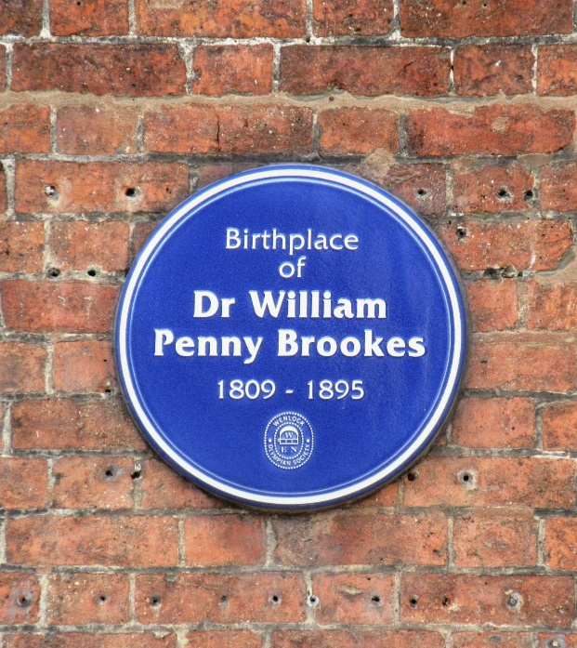
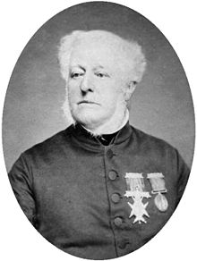
William Brookes
William Brookes was born on 1809 and died on 1895
William Brookes was born in Much Wenlock
There was a school named after William Brookes
He was English
His education was a doctor of medicine and he was a surgeon

Slide 2
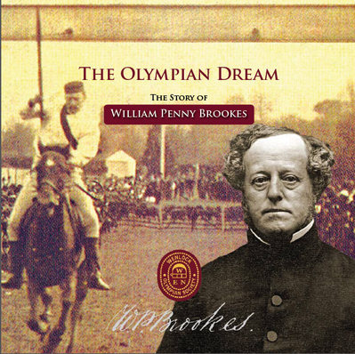
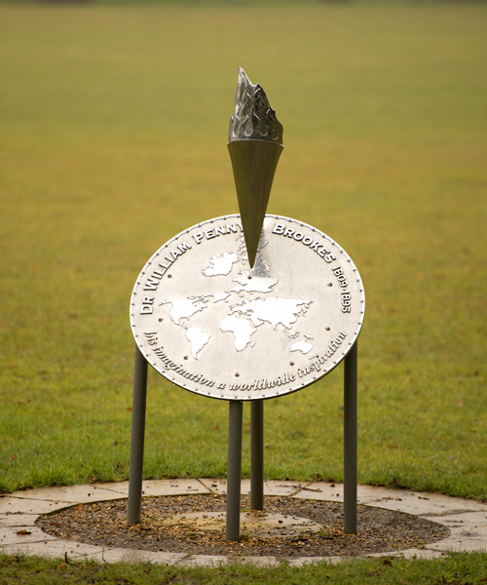
William Brookes was known for the founder of the Wenlock games.
The Olympian class was set up in 1850.
The first ever Wenlock Olympian games was in 1850.

