Slide 1
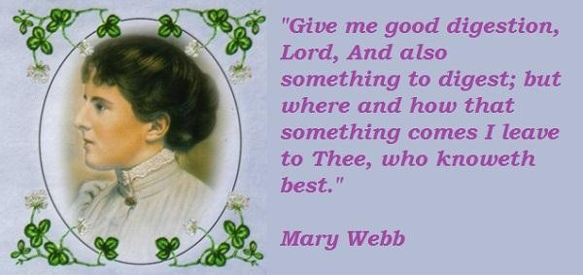
Mary Webb

Slide 2
MARY WEBB
Mary Webb was born 25th of march 1881 and died on the 8th of October 1997. She was born in Lethington lodge Shrewsbury near the wrekin. Her father, George Edward Meredith was an oxford M.A and teacher. He became a great influence in her life. She shared his love of literature and of the countryside. The Celtic influence of her parentage was strong. Her father was proud of her welsh decent. Her mother, Sarah Alice Scott was from a Edinburgh family Reputedly connected

